Slide 1

SmartHub
Product concept for Nest Labs
by Ermolchik Dmitry

Slide 2
The idea of smart house

Slide 3
What we are waiting for smart house?
Make our life more comfortable and safety
Take care about our relatives
Save time
Save money
Save our planet

Slide 4
Smart house problems
Consumers are very conservative
No one know how to interact with smart house
No one know what is smart house should exactly do
Privacy threats

Slide 5
Current smart house facilities
Video surveillance
Climate control
Appliance remote control
Electricity control

Slide 6
Do it yourself vs vendor solution

Slide 7
Pro and con of DIY smart house
Pro
You can choose devices of any vendor
You can save money (single smart lamp cost less than 50$)
You can install equipment by yourself
All this is plug and play devices
Con
This is home automation, not smart house
All systems work separately
Everyone equipment needs his application
Workfolow modification limited

Slide 8
Pro and con of vendor smart house
Pro
All systems work together
One remote control for your house
Turn-key solution
Con
It’s very expencive
Increasing of facilities are limited
You can’t replace vendor device by your own

Slide 9
Introducing Nest SmartHub
Take best of both worlds
Supporting all types of wireless connection (WiFi, Bluetooth, ZigBree, Z-wave)
Remotely update devices controlling protocols
Enterprise business process management engine for best use case
Cloud computing power to make your home smarter
It’s learning by you

Slide 10
How does it work?
Home
Internet
Smart devices
Sensors
Nest SmartHub
High performance cloud computing
High scalable platform
Unlimited data storage
Self-study algorithms
Personal use case patterns builder

Slide 11
Home
Smart devices
Sensors
Cameras
Smart Hub
SmartHub controlling all your devices
Low latency command response
Works if your internet connection down

Slide 12



Base of Nest services is software container runs inside high performance clod platforms

Slide 13

Nests’ services run inside docker

Slide 14


When our users grow, our services grow too

Slide 15
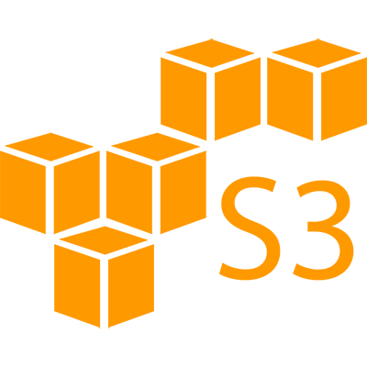

All database data, service configuration and users’ data stored inside safety cloud storage with unlimited space

Slide 16
SmartHub facility

Slide 17
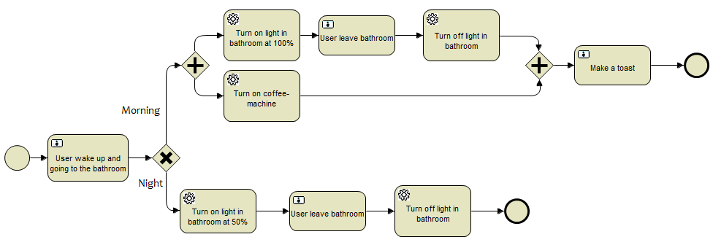
Using pre-designed patterns

Slide 18

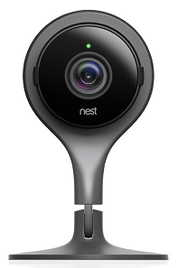




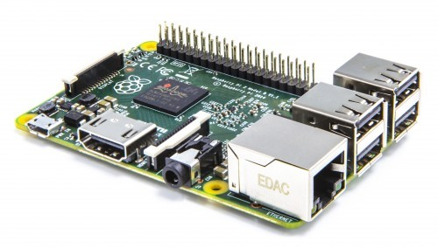



Studying
Smart Hub
Bad cat!
Bad cat!
Bad cat!
Smart Hub

Slide 19
Repeating
Bad cat!
Bad cat!
Smart Hub

Slide 20
What do we need to build SmartHub
Hardware platform with Linux base OS support (any ARM or x86 based platform)
Cloud computing provider (AWS, Google Cloud Platform)
Vendors API to communicate with smart devices
Image recognition and analysis API (Cloud Vision API, Clarifai, …)
Business process management system (Activiti)

Slide 21
Technical scheme

Slide 22




In house
Vendor API
Lamps
Temperature sensor
Cameras & motion detector
Others sensors
Smart Hub
REST API

Slide 23

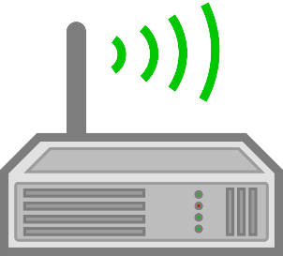
In big house
Vendor API
Temperature sensor
Lamps
Repeater
Others sensors
Cameras & motion detector
REST API
REST API
Smart Hub

Slide 24



Internet (Cloud computing provider )
Load balancer
Cluster
DB storage, Configuration files, Another data

Slide 25
Conclusion

Slide 26
Conclusion
There is no technical difficulties to build smart house
Dividing responsibility between user’s device and cloud service produce good user experience and unlimited possibility of service improvement
Smart house must watch and learn
Smart house should be part of consumer’s life

